Slide 1
P vs NP
A desperate search
By sandor Dalecke
Notes:
Start: Who wants a Million Dollars?

Slide 2

Notes:
Source: https://www.pexels.com/photo/abundance-bank-banking-banknotes-259027/

Slide 3
P vs NP
A desperate search
By Sandor Dalecke
Notes:
Proof → Million Dollar

Slide 4
Is there a difference between checking a proof and finding one?

Slide 5
Some Basics
P is the class of problems solvable by a Turing machine in polynomial time
Sort a list:
Bubblesort is in O(n²) → P 300^2 = 90 000
NP is the class of problems for which, if the answer is yes, then there's a polynomial-size proof of that fact that you can check in polynomial time.
SAT (Check if a Boolean formula is TRUE):
Checking one solution is easy
Finding a solution? Best we know is Brute Force O(2^n) 2^300 = ?
Notes:
Quicksort, Heapsort, Mergesort are faster ← fun fact: linear possible: How? Ask me later
What about SAT solvers? Often very good, but worst case still 2^n

Slide 6

Why do we care?
If P = NP:
Fold Proteins
Break most cryptography
Packing Boxes perfectly
Always find the best travel route
Always find the shortest prove for every theorem
Notes:
Proteins
Cryptography
Box Packing
Travel-Route
Shortest Theorems
AND Money

Slide 7

Notes:
Source: https://www.pexels.com/photo/abundance-bank-banking-banknotes-259027/

Slide 8
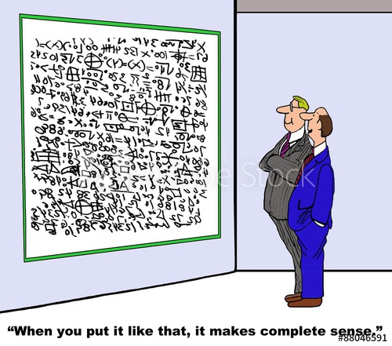
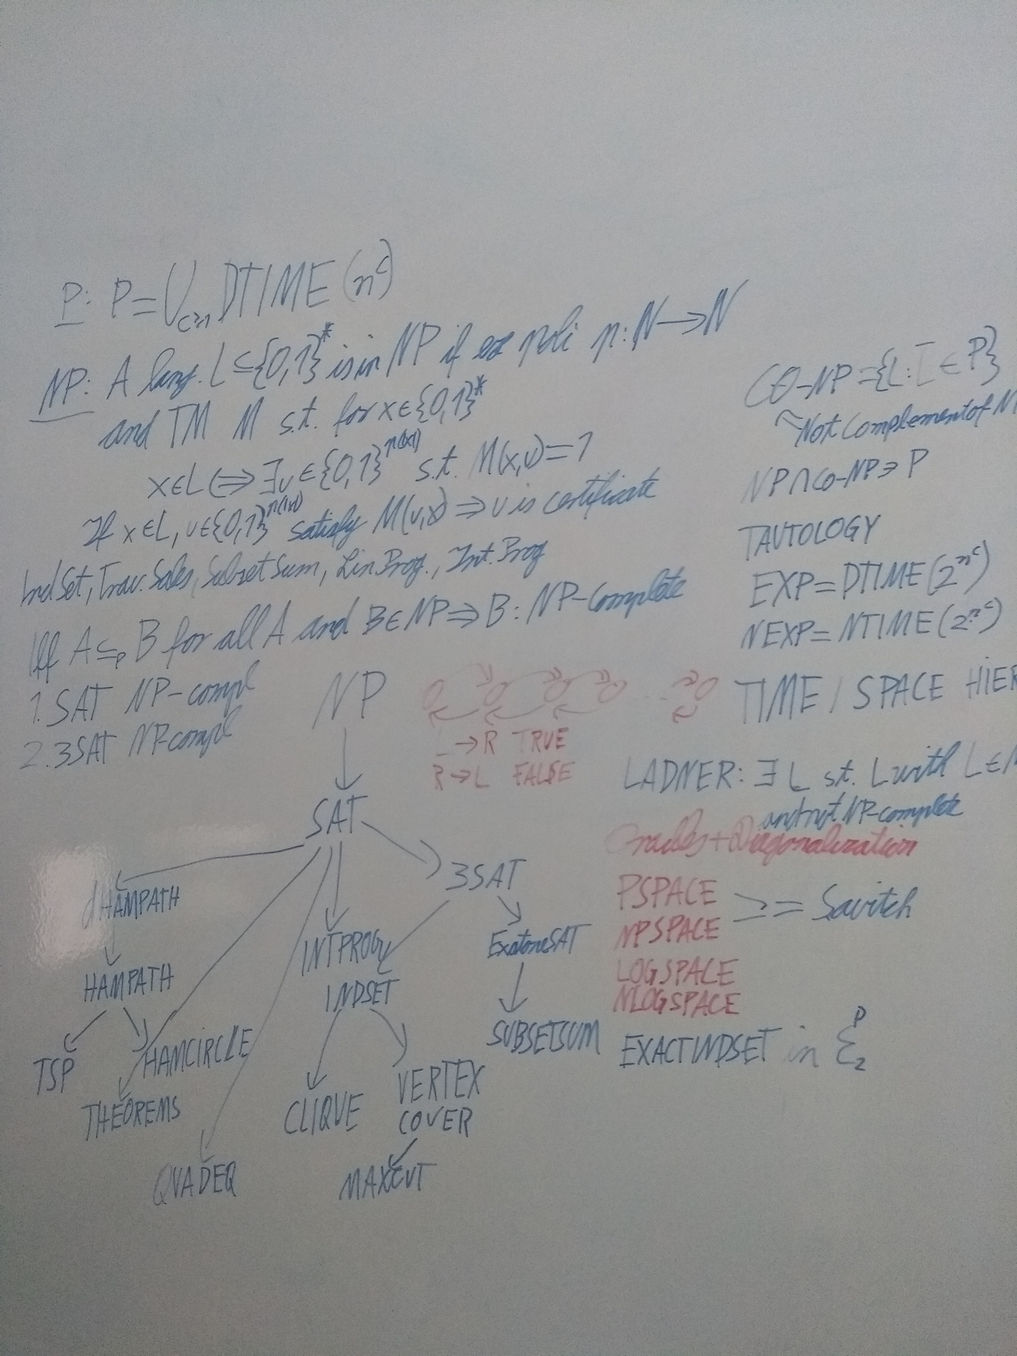
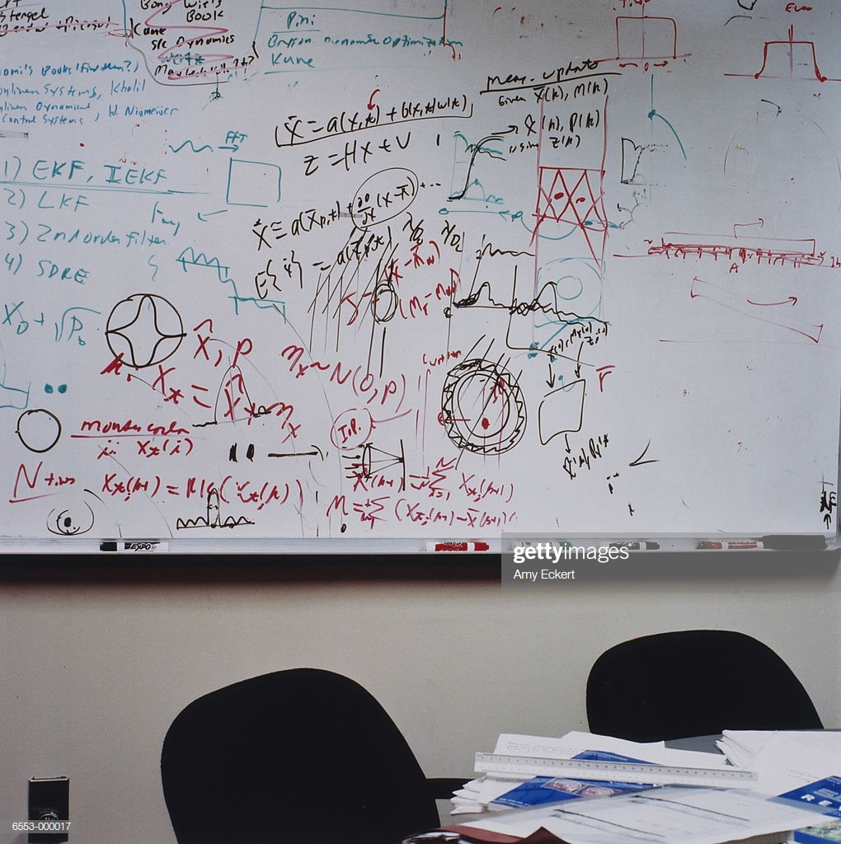
let‘s prove this: Use Math!
Notes:
So you start with the basics
At some point you get here
Aaand then there
Lets not do this
Sources:
Middel: gettyimages Right: https://stock.adobe.com/images/business-cartoon-showing-two-businessmen-looking-at-complex-writing-on-a-whiteboard-one-man-says-when-you-put-it-like-that-it-makes-complete-sense/88046591

Slide 9


Method: Complement
P = Co-P
SATISFIABILITY vs TAUTOLOGY
IF NP ≠ Co-NP → P ≠ NP
We don‘t know
Notes:
Not exactly the opposite but the complement
One correct instead of ALL have to be correct
Source: Made with imgflip.com

Slide 10
Method: Maybe Space?
PSPACE: Computation in Polynomial Space
Obviously NP ⊂ PSPACE
… well NP ⊆ PSPACE is true!
Notes:
Poof by intimidation
But we don‘t know if it isn‘t the same.

Slide 11

Method: Well…How about Randomization?
BPP (Bounded-Error Probabilistic Polynomial-Time)
Accept computation 2/3 if answer is YES
Accept computation 1/3 if answer is NO
P ≟ BPP ≟ NP
BPP is it‘s own monster
Notes:
Think of a coin slightly more likely to land on one side. After a few tosses no idea. But after a million → pretty sure
BPP is very powerful… but different to NP… we think
Source: Made with imgflip.com

Slide 12

Okay okay… Quantum Computing!
BQP (Bounded-Error Quantum Polynomial-Time)
BPP on Quantum Computer
Just try everything!
Not how QC work!
Probably BQP ≠ NP
Notes:
People who want to know more about QC: https://www.scottaaronson.com/blog
Source: Made with imgflip.com

Slide 13

Screw this: Let‘s try Oracles!
Let‘s pretend we have an Oracle
Knows answer to P or to NP or EXP or …
„…the relativized P =? NP question has a positive answer for some oracles and a negative answer for other oracles. We feel that this is further evidence of the difficulty of the P =? NP question.“ Baker, Gill, Solvay
Notes:
Answer depends on power of oracle…
Source: Made with imgflip.com

Slide 14
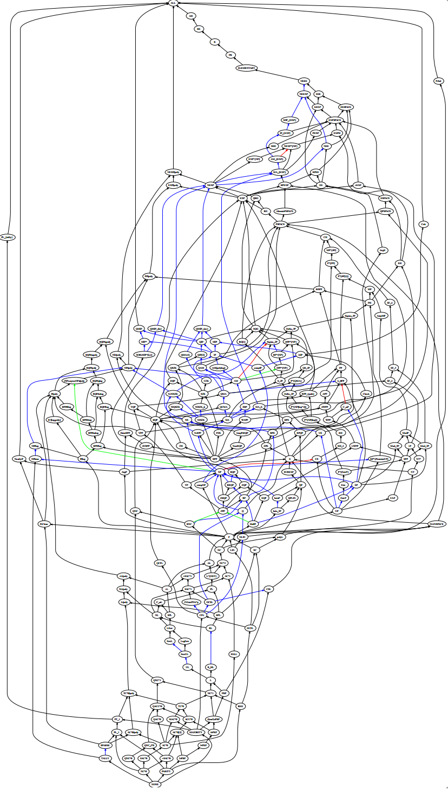
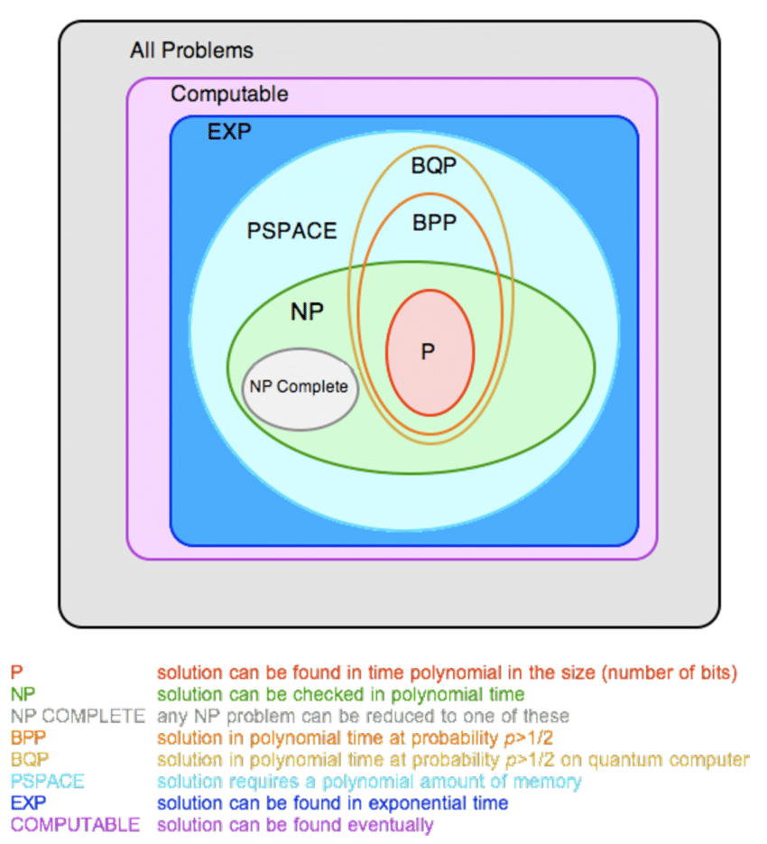
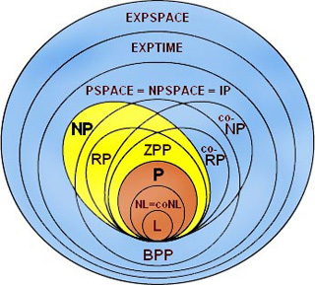
And that was just a glimpse!
Notes:
Sources:
Left: https://www.researchgate.net/figure/Venn-Diagram-of-Complexity-Classes-in-Currently-Believed-Structure_fig10_51932027
Middel: https://brilliant.org/wiki/complexity-classes/
Right: https://www.math.ucdavis.edu/~greg/zoology/diagram.xml ← Interactive map

Slide 15
Thanks you for Listening

